Slide 1
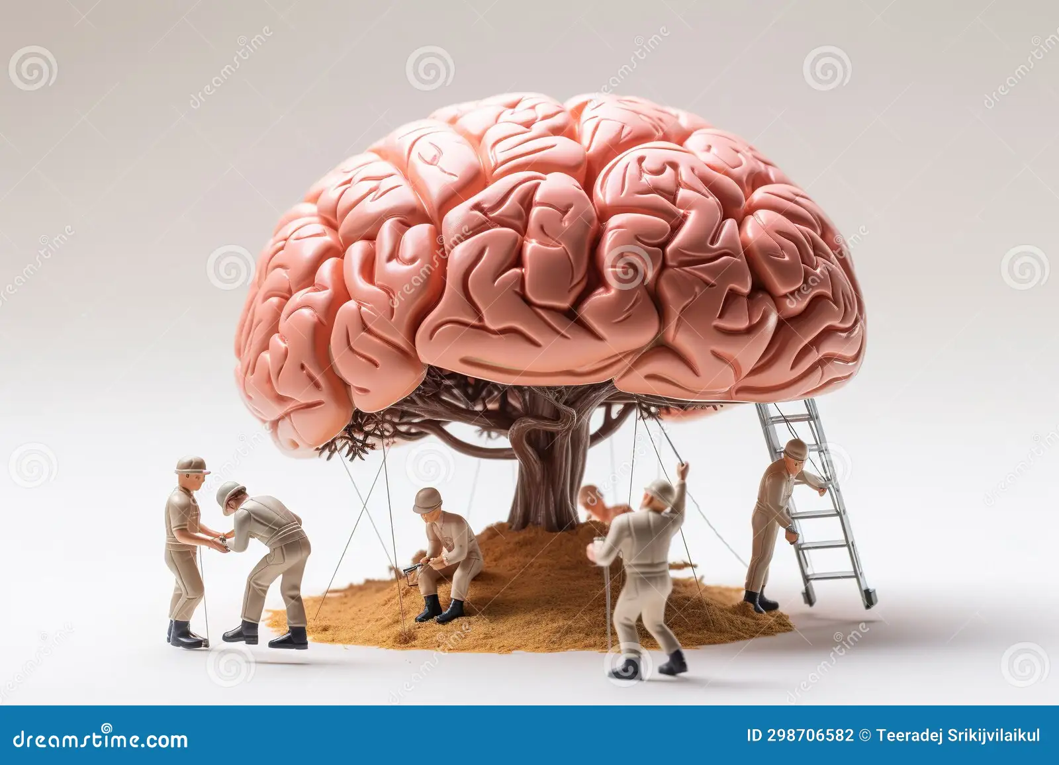
Teamno-20
Sec-1
2320030039-T.Pranavanadh 2320030175-P.Abhideep 2320030292-A.Saisirish 2320090038-K.Vignesh
Title: Brain Stroke Detection using ML
ProblemStatement: Create a simple tool to predict a person's risk of having a stroke, helping doctors catch it early and prevent it
Algorithm:
Gather patient data with features like age, gender, and health conditions, along with whether they had a stroke or not.
Preprocess Data: Clean the data and convert categorical variables to numbers.
Split Data: Divide the data into training and testing sets.
Choose Model: Select a machine learning model, such as logistic regression or decision tree.
Train Model: Train the model using the training data.
Evaluate Model: Test the model with the testing data to check its accuracy.
Make Predictions: Use the model to predict stroke risk for new patients.
DataSet:
Collect patient data with features like age, gender, and health conditions( hypertension, Glucoselevel, Bmi, smoking status), along with whether they had a stroke or not.
From KAGGEL
https://www.kaggle.com/datasets/zzettrkalpakbal/full-filled-brain-stroke-dataset/code

